Slide 1
Special Use Permit WSUP18-0008
Washoe County Board of Adjustment
August 2, 2018
Arconic Expansion

Slide 2
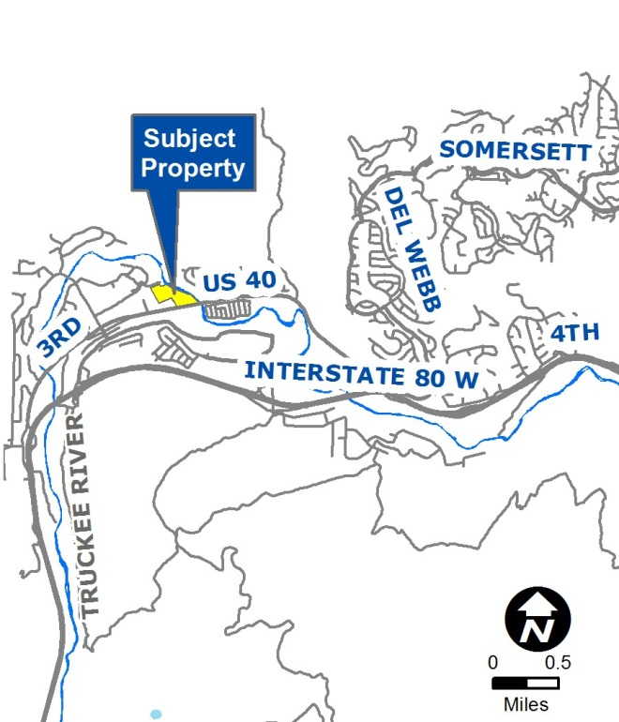
Vicinity Map
Located in Verdi, Nevada
1 Eric Circle (APN: 038-060-36)
North of U.S. 40, Adjacent to the Truckee River
Existing, legal non-conforming heavy industrial use.
Zoned industrial
Has operated at this location since 1967, held business licenses since 1971.

Slide 3
Overview of Request
To allow for the expansion of an existing legal non conforming use.
Due to the applicant wanting to expand current operations past the allowed 10% as described in WCC Section 110.904.20 (a) (1), a Special Use Permit is required.
Existing structure is 130,000 square feet.
Proposed expansion is 109,000 square feet.

Slide 4
Staff Concerns
Noise, operation noises during early morning
Lighting, existing and proposed
Traffic generation
Outdoor Storage
Proximity to the Truckee River
Hazardous Materials
Environmental Concerns

Slide 5
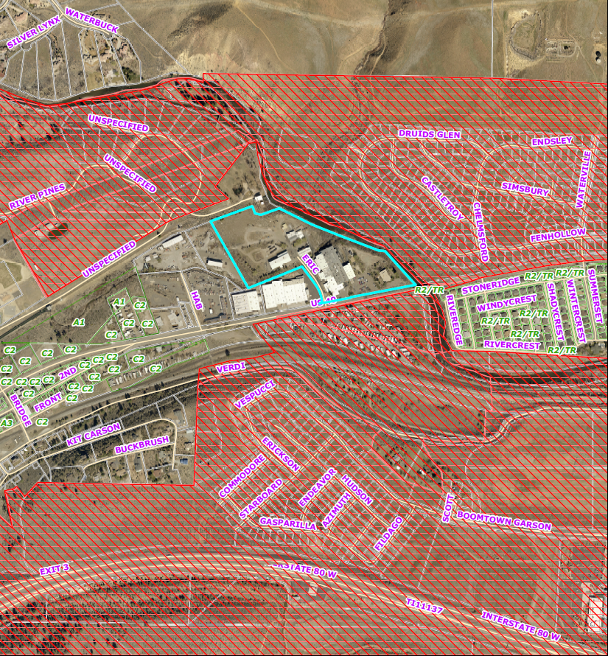
Aerial View
City of Reno
SUBJECT
PARCEL

Slide 6
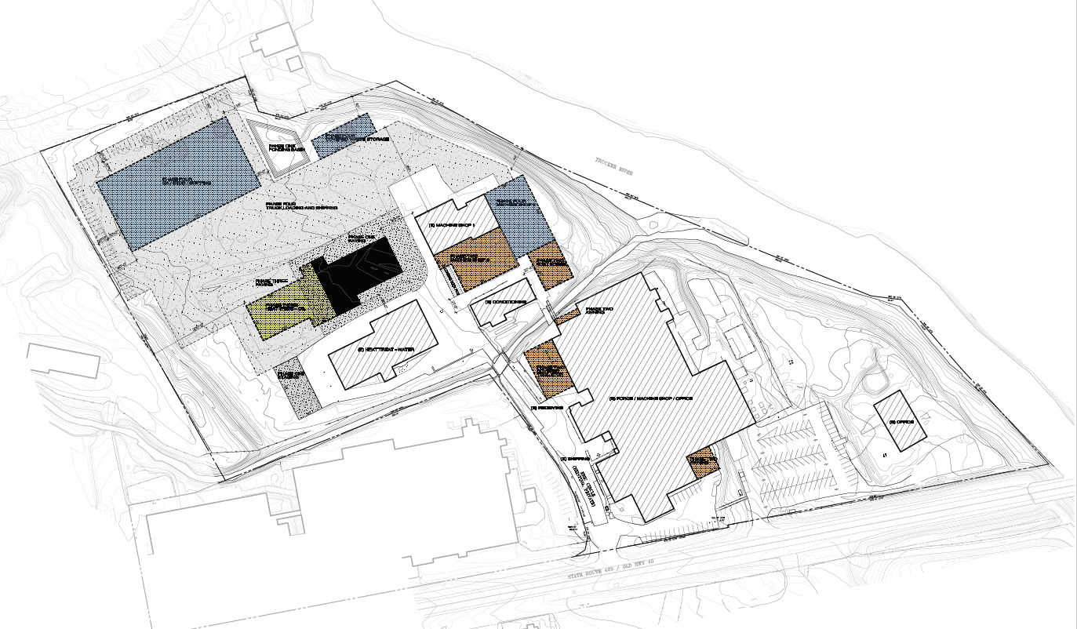
Site Overview

Slide 7
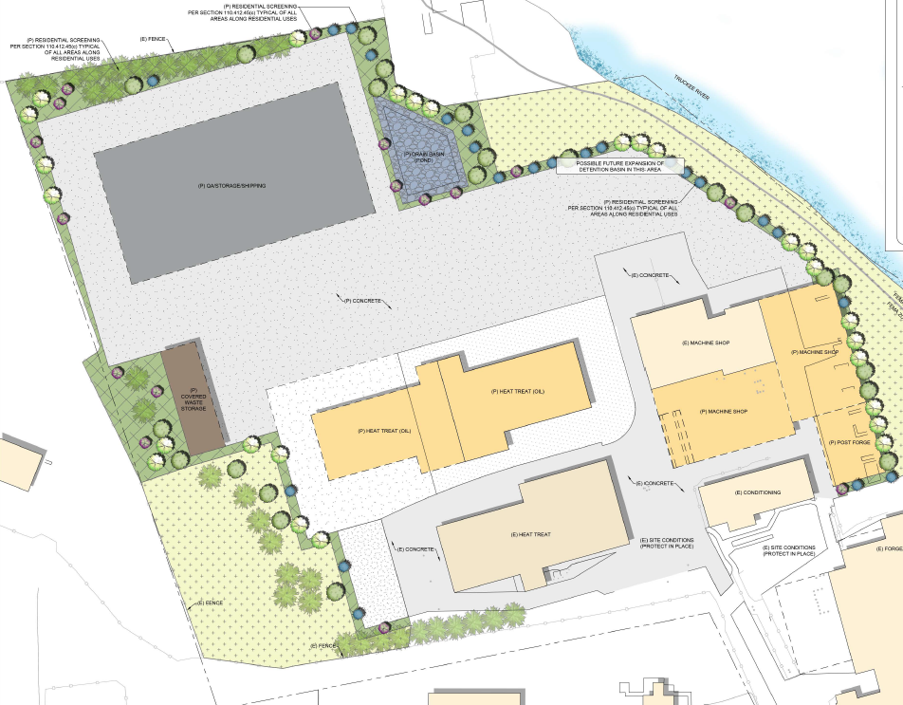
Site Plan
Proposed
Storage
Proposed
Covered Waste
Proposed Machining
Proposed Heat Treatment

Slide 8
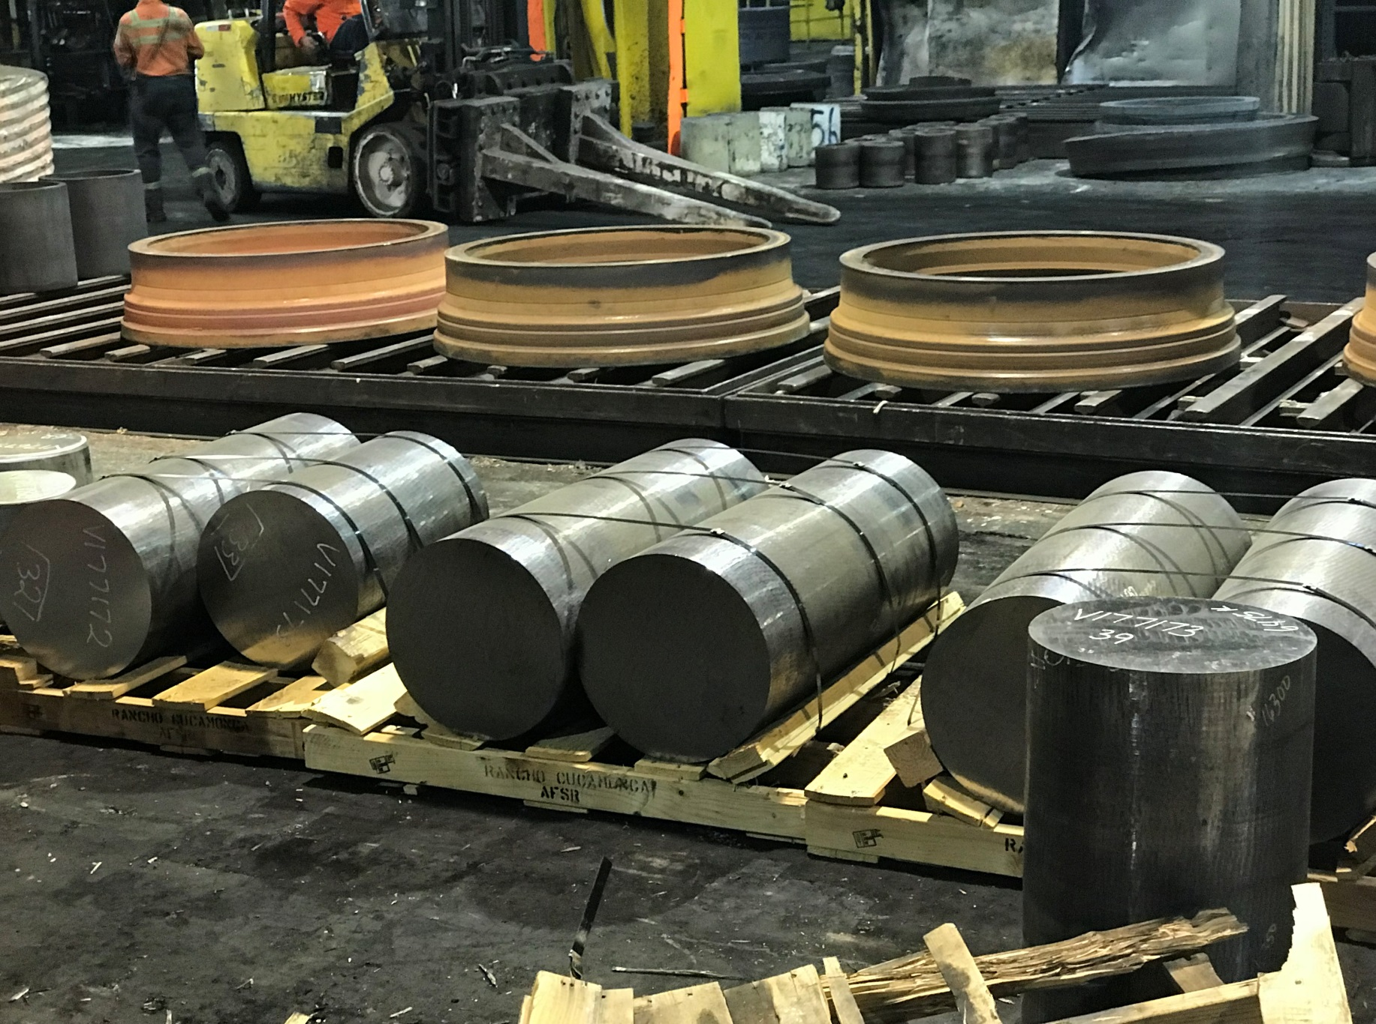
Photos (Raw Materials)

Slide 9
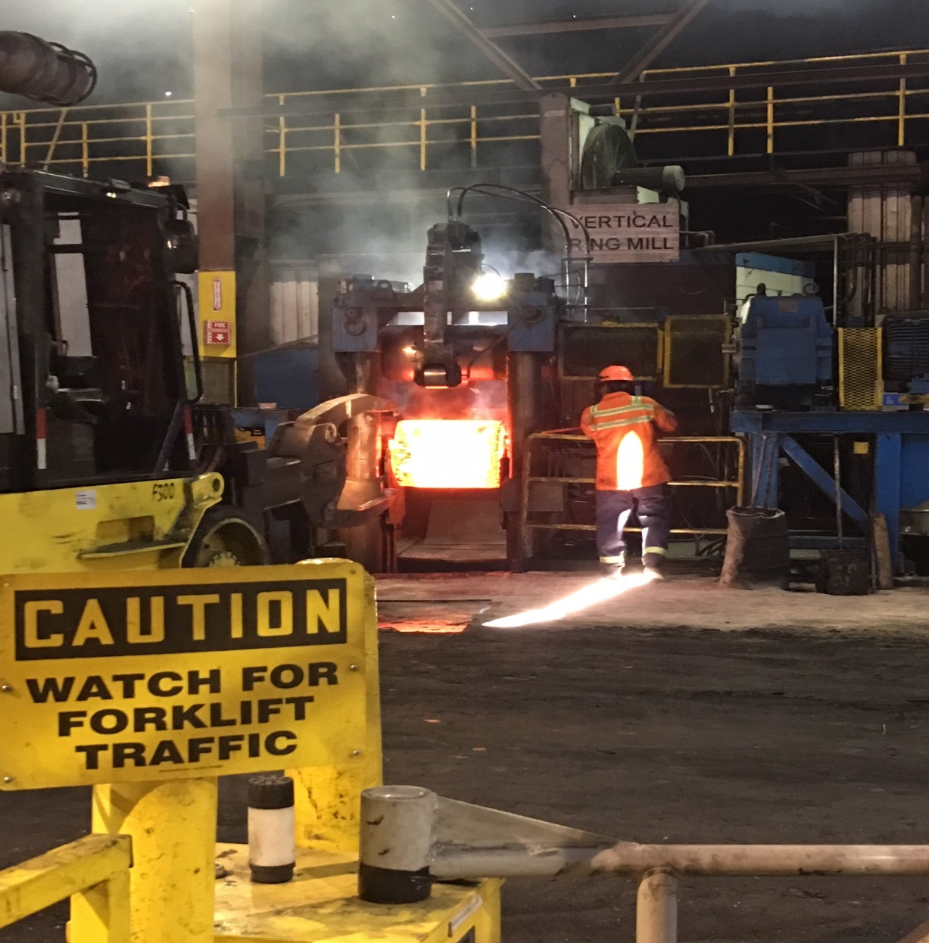
Photos (Forging)

Slide 10
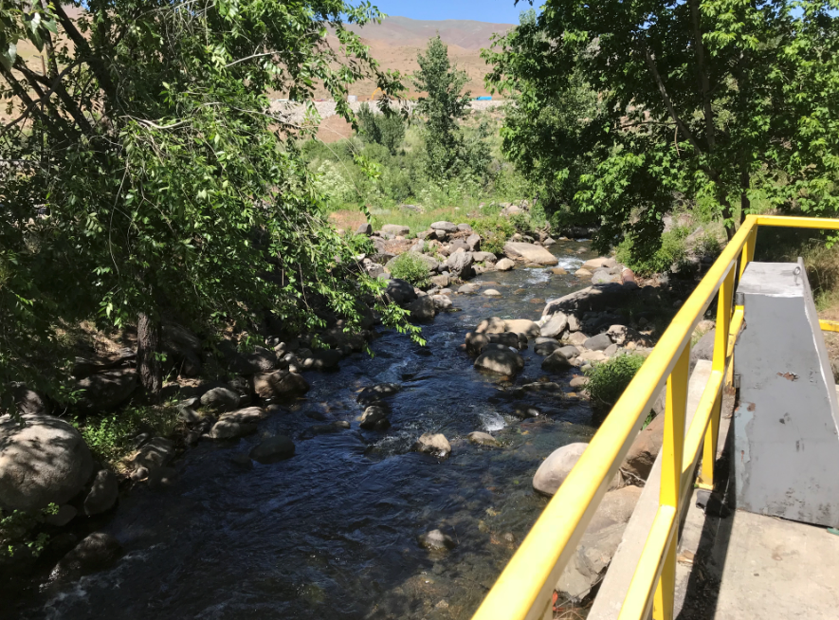
Photos (TMWA Channel)

Slide 11
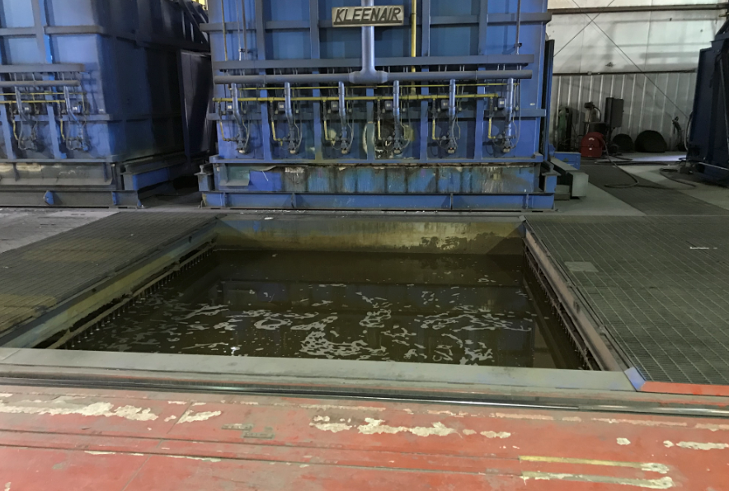
Photos (Heat Treatment)

Slide 12
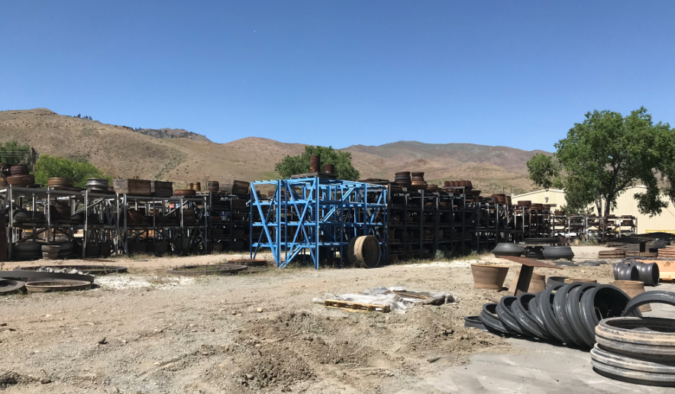
Photos (Outdoor Storage)

Slide 13
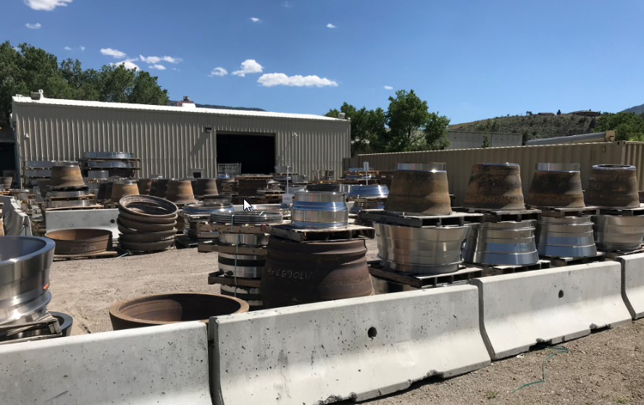
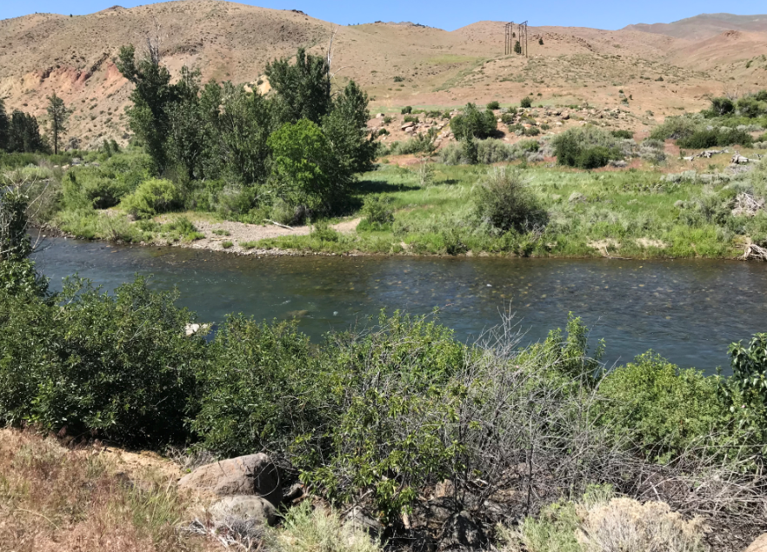
Photos (Proximity to River)

Slide 14
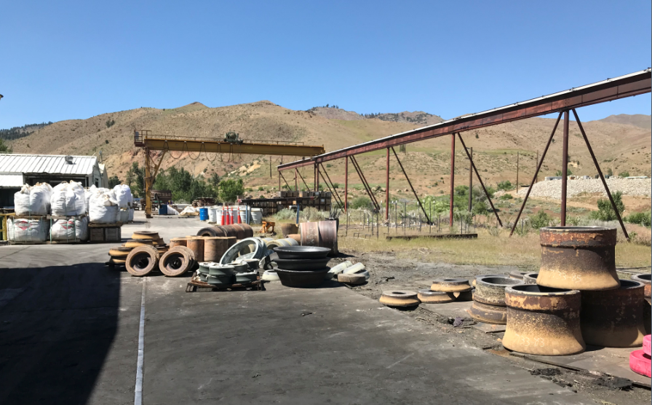
Photos
City of Reno Subdivision

Slide 15
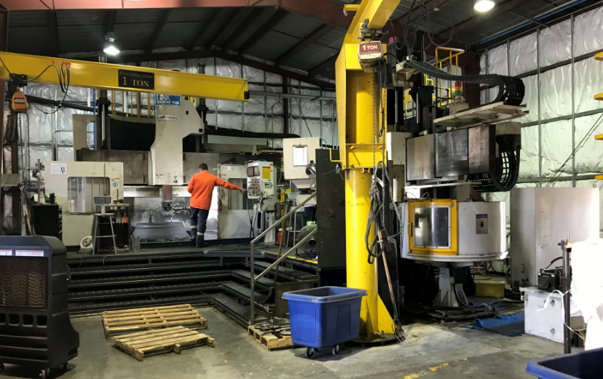
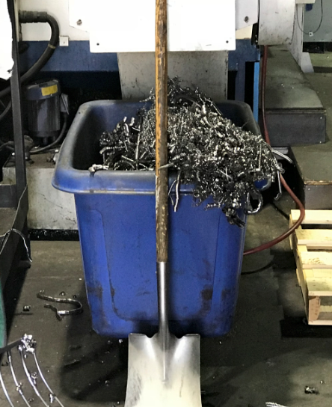
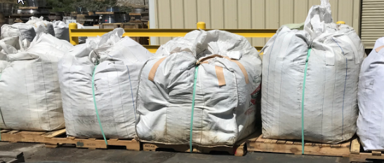
Photos (Machining)

Slide 16
Citizen Advisory Board (CAB)
June 18: West Truckee Meadows / Verdi Township
Voted unanimously to approve with conditions
Discussion on:
Water availability
Groundwater pollution
Lighting and noise

Slide 17
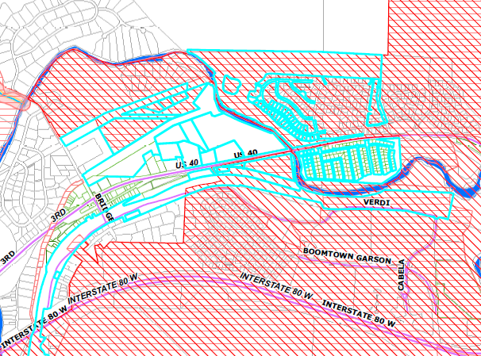
Public Notice
Notice provided to 63 property owners

Slide 18
Reviewing Agencies
Washoe County Community Services Department
Planning and Building
Engineering and Capital Projects
Utilities
Regional Parks and Open Space
Truckee Meadows Fire Protection District
Washoe County Health District
Nevada Division of Environmental Protection
Regional Transportation Commission
Washoe-Storey Conservation District
Truckee Meadows Water Authority

Slide 19
SUP Finding #4
Issuance Not Detrimental. That issuance of the permit will not be significantly detrimental to the public health, safety or welfare; injurious to the property or improvements of adjacent properties; or detrimental to the character of the surrounding area;

Slide 20
Staff Comment on Finding #4
Staff Comment: TMWA has provided public records from NDEP on contamination events from the project site. Based on those records, the last event occurred in 1980, and the case was closed by NDEP. No NDEP recorded contamination events of the Truckee River have occurred since that year. Staff worked with NDEP, TMWA, and the Washoe County Health District in the review of the proposed project. There are proposed conditions from TMWA, the Health District, and the City of Reno regarding mitigation efforts from potential site runoff to the Truckee River. Furthermore, staff has received proposed conditions related to noise, lighting, landscape buffers, and secondary containment of materials which will minimize impacts to the surrounding area. Due to this, staff concludes that this finding can be met and that Arconic and its expansion is not expected to cause significant detriment or injury to the public, adjacent properties, or surrounding area.

Slide 21
Possible Motion
I move that, after giving reasoned consideration to the information contained in the staff report and information received during the public hearing, the Washoe County Board of Adjustment approve, with the conditions included as Exhibit A to this matter, Special Use Permit Case Number WSUP18-0008 for Arconic, having made all five findings in accordance with Washoe County Code Section 110.810.30, and the one finding in accordance with the Verdi Area Plan. This approval includes additional conditions 1(p), 1 (q) and 2 (ee):

